Slide 1
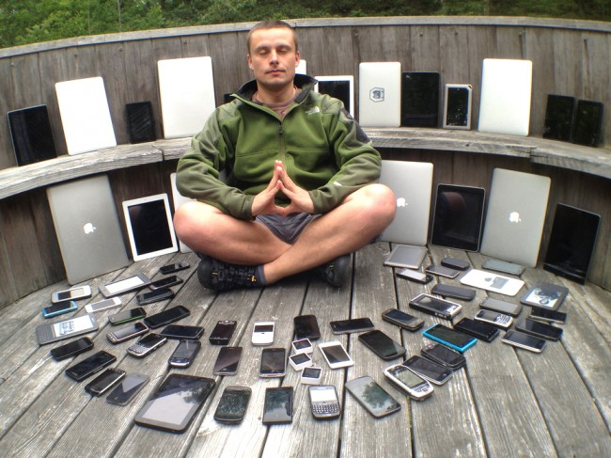
Thesis:
We are heading towards a digital society (digital economy?),
where smartphone is the center of our universe
All business, companies, societies, families and individuals
will adopt a philosophy of mobile first
1

Slide 2
Supporting Facts
# of local apps among Top 100 apps in Indonesia
Source: Nielsen
Source: playboard
Source: Niometrics (Indosat)
# of apps downloaded in a month per user in SEA (2015)
Source: Deloitte
Source: wearesocial
Source: Statista
2

Slide 3
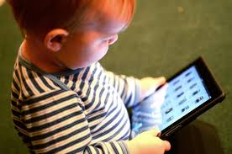



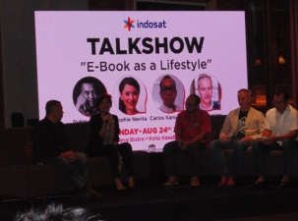

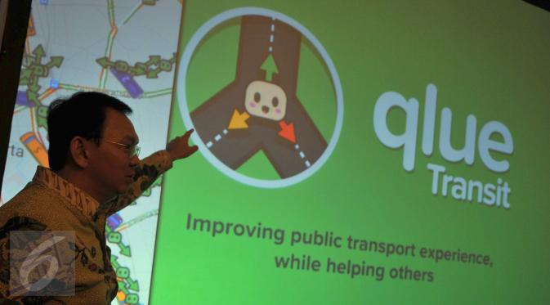
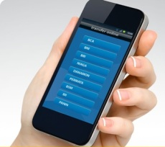



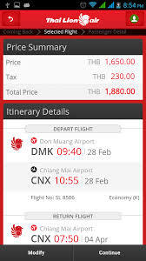


Smartphone are held by younger members of the society, guided by the older, we rely more and more on smartphone
Everyone is pushing digital:
Cheaper, direct access to market/consumer
New business opportunity, opportunity to scale-up
3

Slide 4












The key is apps development
Starting where it is:
“simple”;
“where the money is”
Looking at niche areas
4

Slide 5


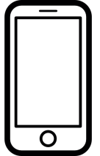




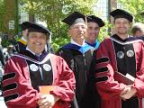











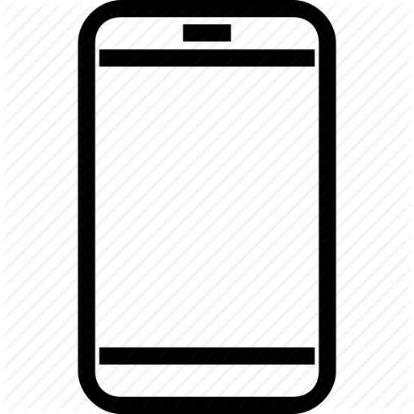








How a digital day looks like
00:00
06:00
09:00
12:00
15:00
18:00
21:00
03:00
00:00
06:00
09:00
12:00
15:00
18:00
21:00
03:00
students
professor
00:00
06:00
09:00
12:00
15:00
18:00
21:00
03:00
00:00
06:00
09:00
12:00
15:00
18:00
21:00
03:00
doctor
housewife
5
3

Slide 6

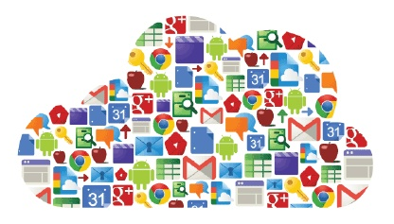
Next 4-5 years : transition
The young is using apps at an early age
Everyone in between is using
The old is using also
Based on stats, the trend is not going to slow down.
If anything, it will grow exponentially
6

Slide 7
Thank You

